Slide 1
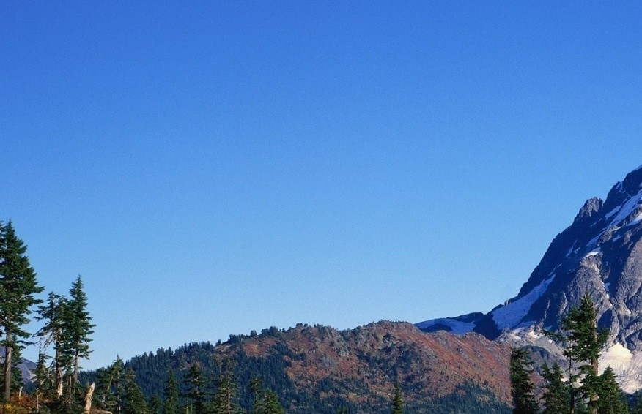
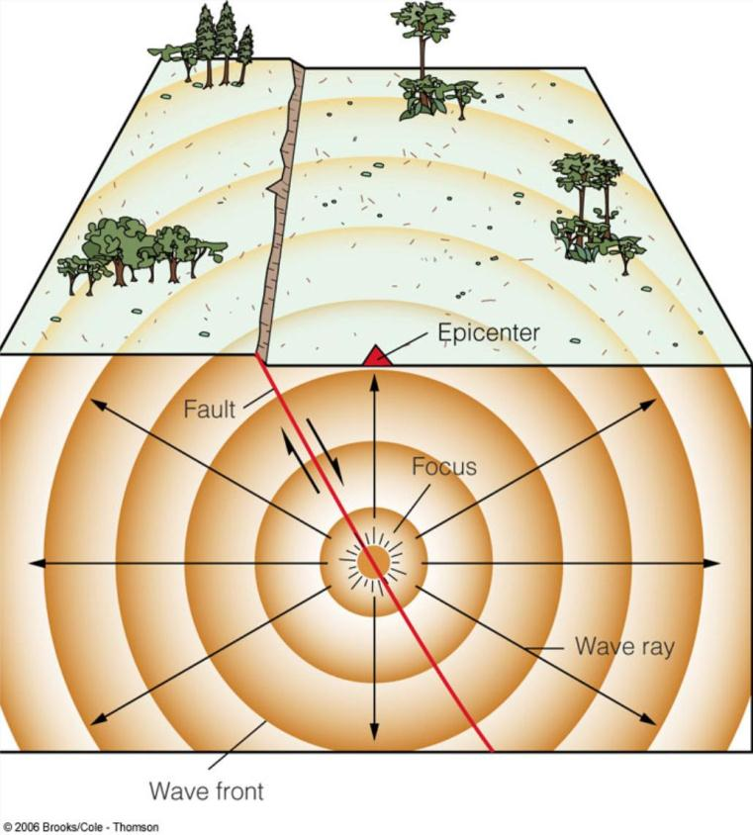
Earthquakes
They result from the rupture of rocks along a fault.
Energy from an earthquake is released in the form of seismic waves.
They are mapped according to the epicentre; the focus is located directly below the epicentre.
They are measured by
seismographs and compared
by magnitude.

Slide 2
Earthquake Magnitude
The magnitude of an earthquake is expressed as a number to one decimal place.
This type of measurement was first developed by seismologist Charles Richter in 1935
The Richter Scale was a measure of the strength of a wave 100 km from the epicentre.
Since then, more accurate methods have been developed and the Richter Scale is no longer in use

Slide 3
The Moment Magnitude Scale
Today, earthquakes are compared using the Moment Magnitude scale (M).
The scale is determined by:
The area of rock ruptured along a fault
The distance of movement along the fault
The elasticity of the rock at the focus
Like the Richter Scale, it is a logarithmic scale.
Example: an M7 earth quake represent 10 times the strength of an M6 earthquake

Slide 4
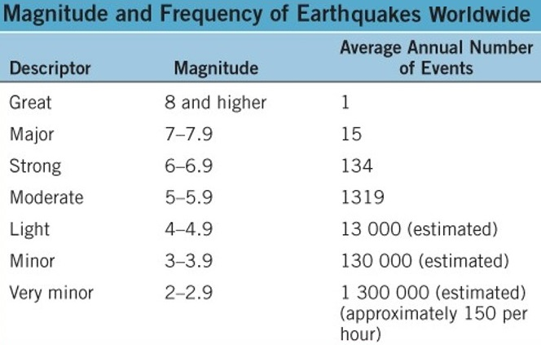
Magnitude and Frequency of Earthquakes
There is no official upper limit on the Moment Magnitude Scale.
The strongest earthquake ever recorded on the scale is M9.5 in Chile in 1960. In Canada, it is M8.1 in B.C. in 1949.
There are only a few M9+
earthquakes each century

Slide 5
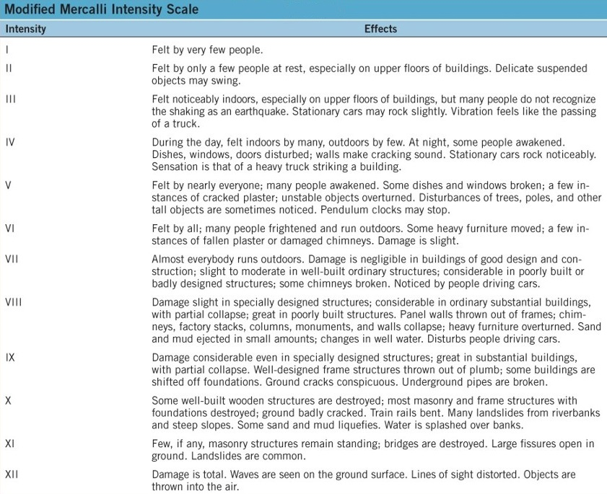
The Modified Mercalli Intensity Scale
This is a qualitative scale based on damage to property and the effect of an earthquake on people.

Slide 6
Earthquake Processes
Earthquakes are most common at or near plate boundaries.
Motion at plate boundaries is not smooth or constant.
Friction along plate boundaries exerts a force (stress) on the rocks, exerting strain or deformation
When the stress exceeds the strength of the rocks, there is a sudden movement along a fault.

Slide 7
Earthquake Processes
The rupture starts at the focus and propagates in all directions in the form of seismic waves.
Thus, faults are considered seismic sources.
Identifying faults is necessary to evaluate the risk of an earthquake in an area
Not all faults are down at the earth’s surface. Blind faults are located below the surface

Slide 8
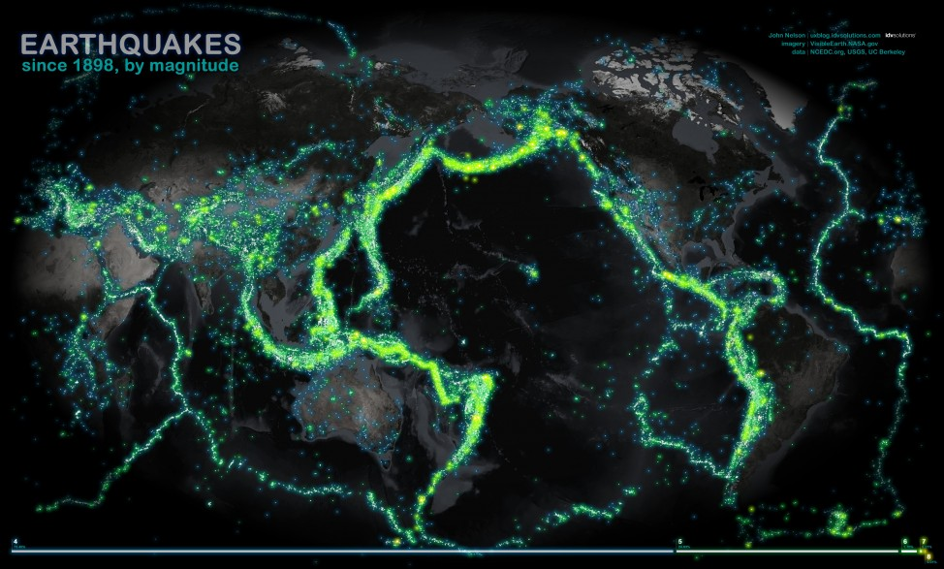
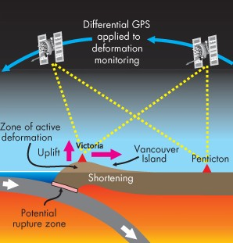
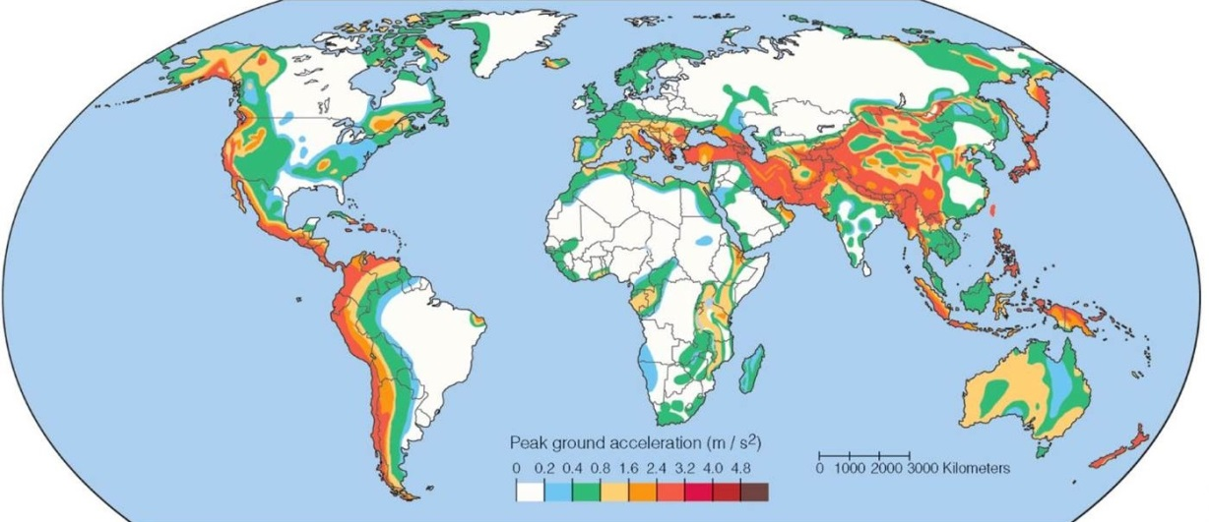
Earthquake Distribution

Slide 9
Fault Types
There are two basic types of geologic faults; they are distinguished by the direction of the displacement of rock.
Strike-slip faults
Displacements are horizontal
Dip-slip faults
Displacements are vertical

Slide 10
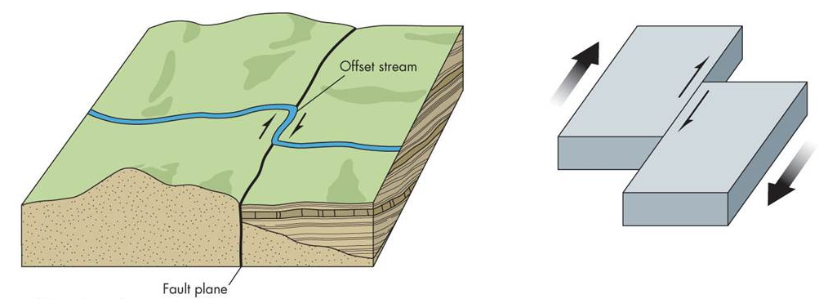
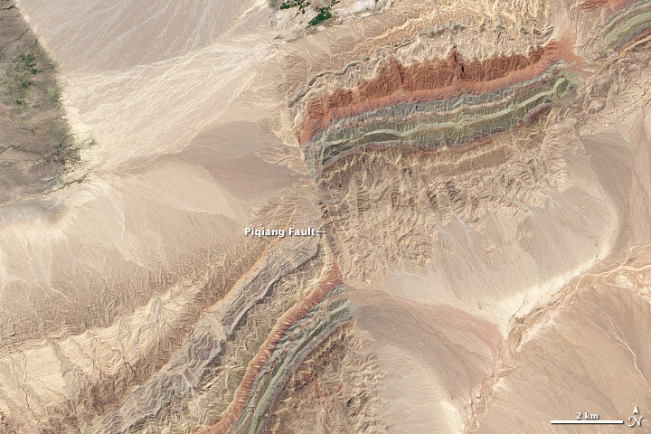
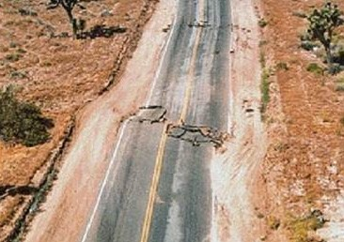
Strike-Slip Faults
The San Andreas Fault is the best example of this type.

Slide 11
Dip-Slip Faults
There are three categories:
Reverse faults, thrust faults, and normal faults
They are comprised of two inclined walls, as defined by miners:
Footwall (where miners placed their feet)
Hanging-wall (where miners placed their lanterns)

Slide 12
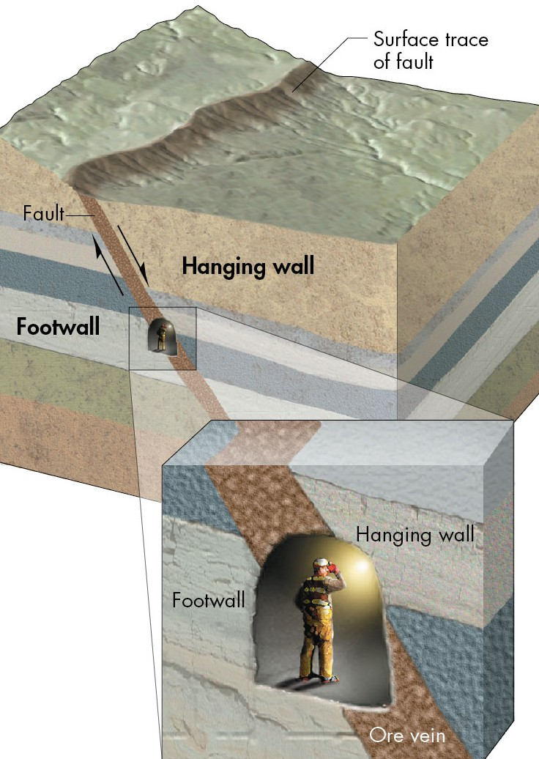
Dip-Slip Faults

Slide 13
Dip-Slip Faults
Reverse Fault:
The hanging wall has moved up relative to the footwall and is inclined at an angle above 45 degrees
Thrust Fault:
These are like reverse faults except the angle is 45 degrees or less
Normal Fault:
The hanging wall has moved down relative to the footwall

Slide 14
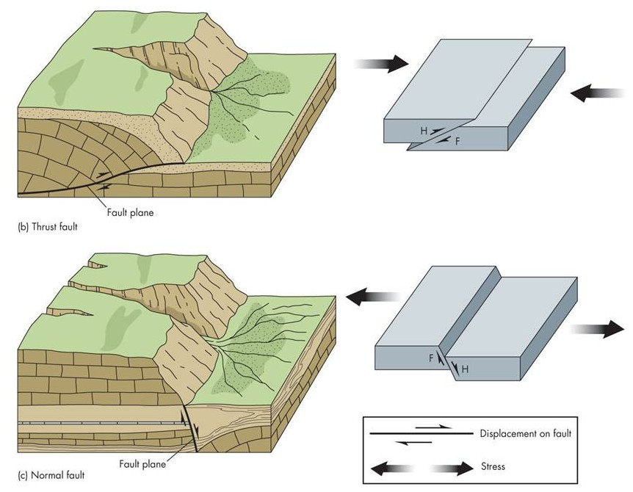
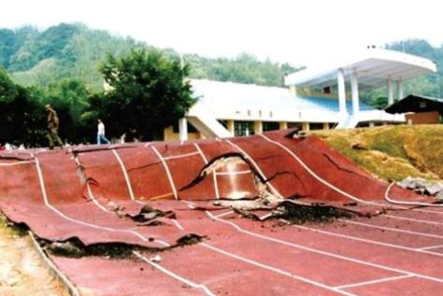
Dip-Slip Faults

Slide 15
Fault Activity
In terms of activity, faults can fall into one of three categories:
Active
Movement during the past 11,600 years
Potentially Active
Movement during the past 2.6 million years
Inactive
No movement during the past 2.6 million years

Slide 16
Tectonic Creep
Definition:
The extremely slow movement of rock along a fracture caused by stress
It is also referred to as fault creep.
This can damage roads and building foundations (movement of a few cm per decade).
Along these faults, periodic sudden displacements producing earthquakes can occur

Slide 17
Seismic Waves
Some seismic waves generated by fault rupture travel within the body of the Earth and others travel along the surface.
Body waves:
These include P waves and S waves
P waves: they are also called primary or compressional waves
They move relatively fast with a push pull motion and can travel through solids or liquids

Slide 18
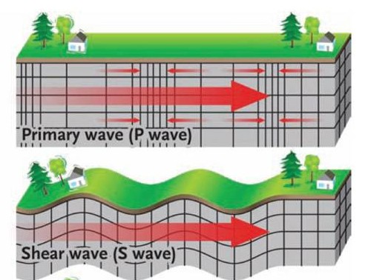
Seismic Waves
S waves
They are also called secondary or shear waves.
They move relatively slow, in an up-and-down motion and can only travel through solid rock

Slide 19
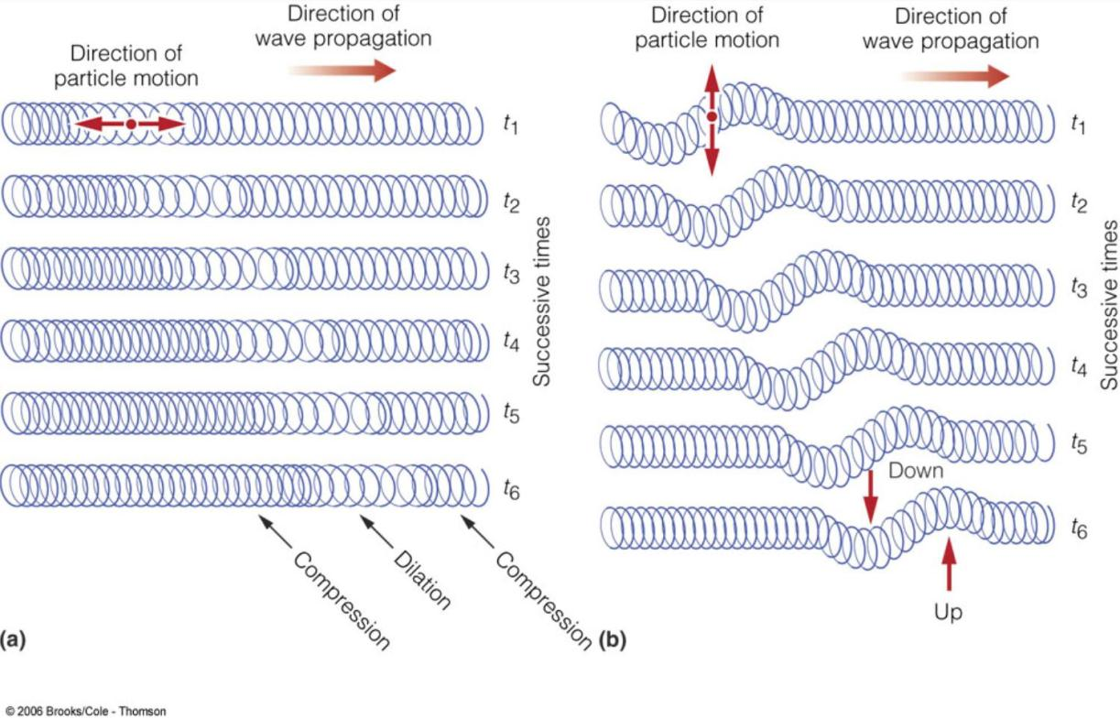
Seismic Waves
P waves S waves

Slide 20
Surface Waves
Definition:
Seismic waves that form when P waves and S waves reach Earth’s surface and then move along it
These waves move more slowly than body waves.
Surface waves are responsible for damage near the epicenter

Slide 21
Earthquake Shaking
Factors that determine the shaking that people experience during an earthquake:
Magnitude
Distance to the epicenter
Focus depth
Direction of rupture
Local soil and rock type
Local engineering and construction practices

Slide 22
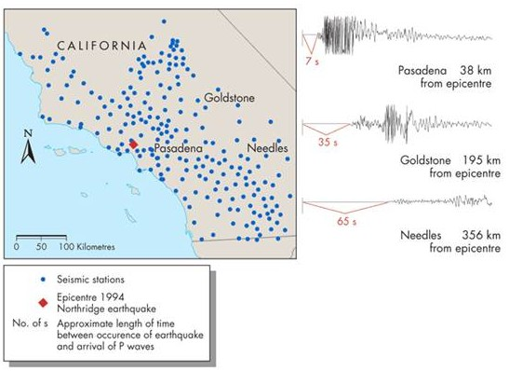
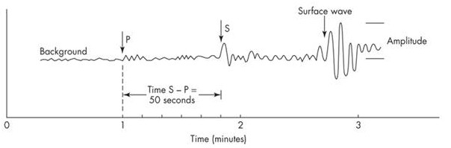
Earthquake Shaking
Seismographs record the arrival of waves to a recording station.
Because P waves travel faster than S waves, they appear first on a seismograph
Earthquake shaking decreases with distance from the epicenter

Slide 23
Distance to the Epicentre
The difference between the arrival times of the P waves and S waves at different locations determine the distance to the epicentre.
The distance to the epicenter is calculated at 3 different seismic stations
A circle with radius equal to that distance is drawn around the station

Slide 24
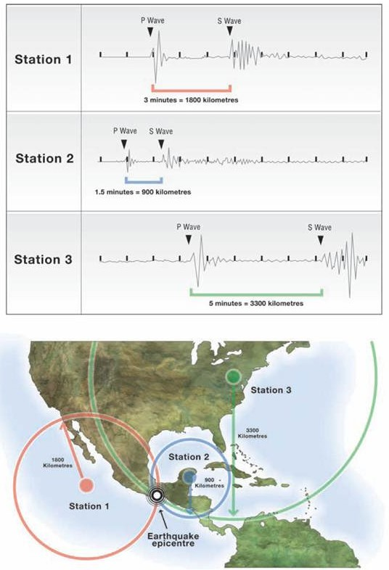
Locating an Earthquake
The epicentre is located where the circles intersect; this process is called triangulation.

Slide 25
Focus Depth
Seismic waves become less intense as they spread outward toward the surface.
Therefore, the greater the focus depth, the less intense the shaking at the surface

Slide 26
Direction of Rupture
Earthquake energy is more focused along the geographic direction of rupture.
This is known as directivity and contributes to increased shaking.
Radiated waves are sometimes stronger along the direction of the fault.

Slide 27
Local Soil and Rock Type
The local geology influences the amount of ground motion.
Dense homogeneous crust can transmit earthquake energy quickly
Seismic energy slows down in areas with heterogeneous, folded, faulted crust.
Implication:
Earthquakes in eastern North America are felt over larger areas than those in western North America

Slide 28
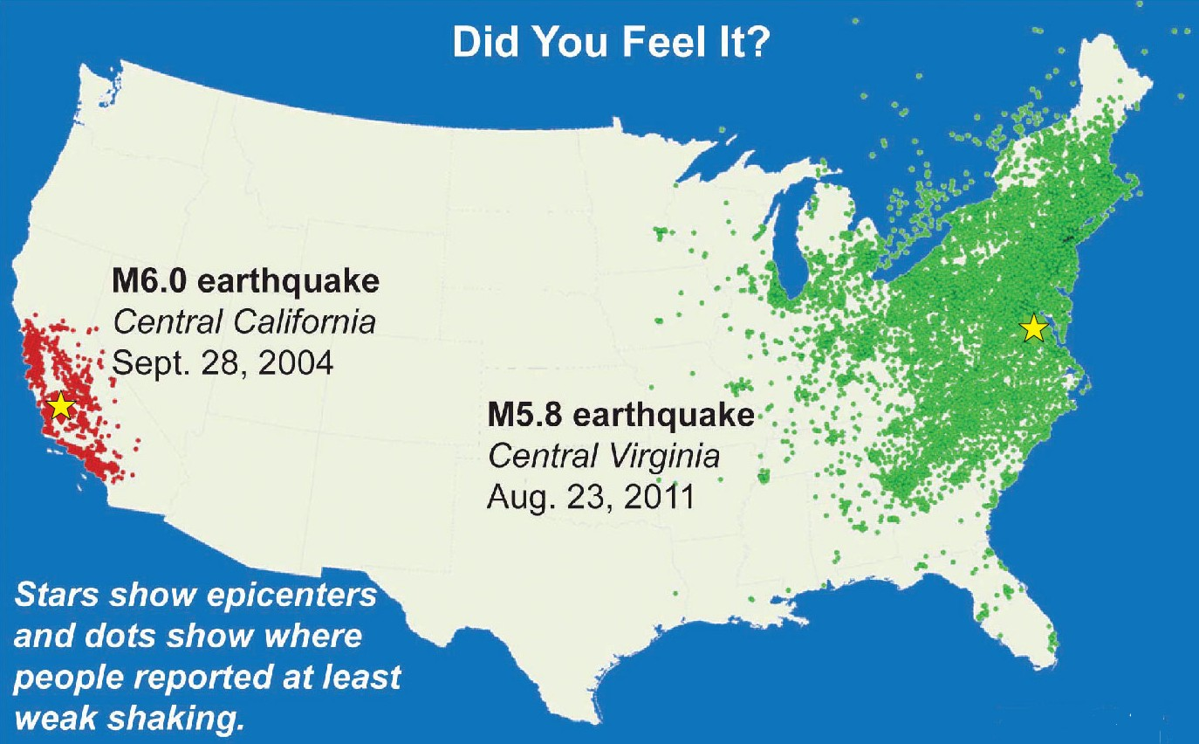
Shaking by Region
The underlying bedrock in eastern North America is more homogeneous than in the west.

Slide 29
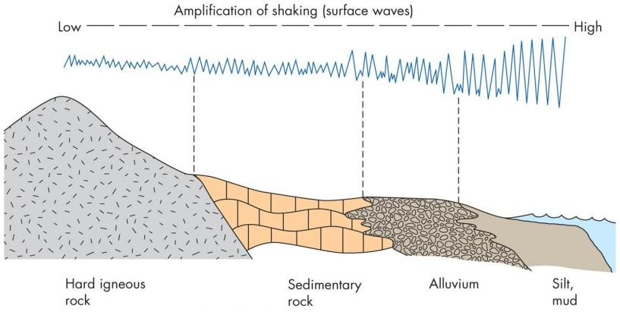
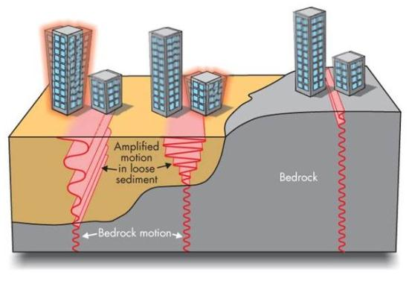
Amplification
Definition:
An increase in ground motion during an earthquake
P waves and S waves slow down as they travel through alluvial sand, gravel, clay, soil, etc.
As the waves slow some of their energy is transferred to surface waves

Slide 30
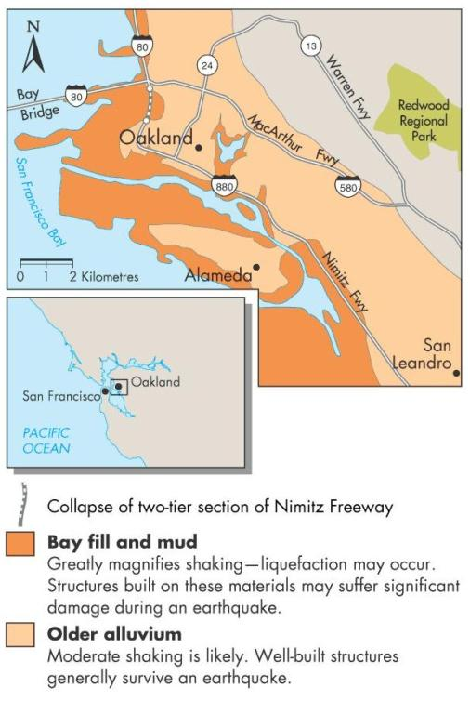
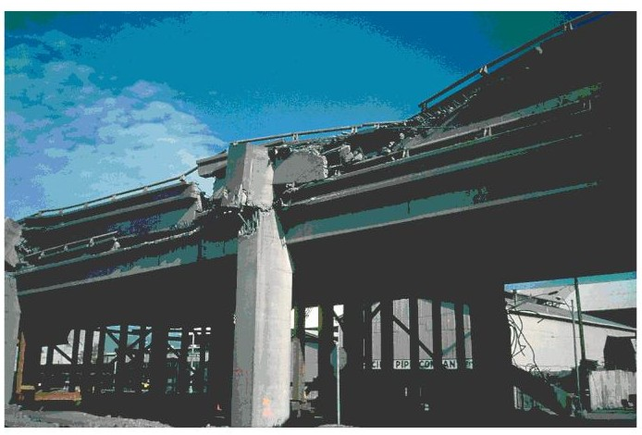
Amplification
Amplification has historically enhanced damage in San Francisco area earthquakes.

Slide 31
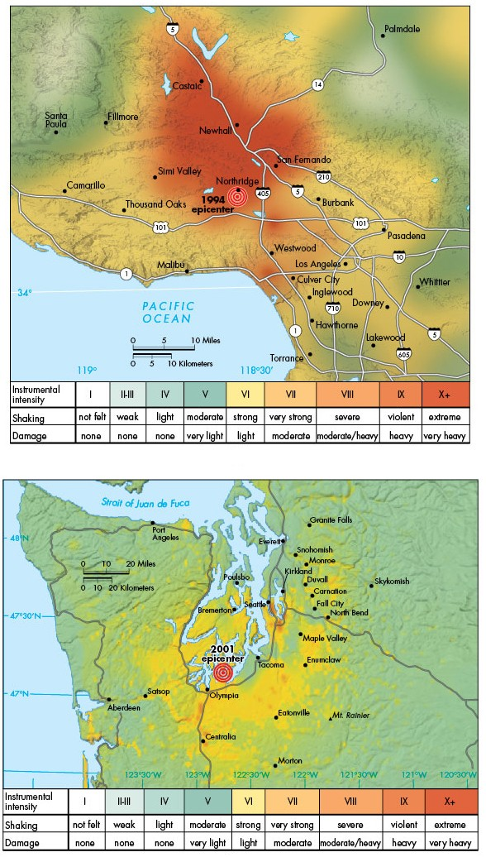
Shake Maps
The combination of all these effects results in widespread variation of the shaking felt in the vicinity of an earthquake.
Therefore, two earthquakes that have the same magnitude can have very different impacts

Slide 32
The Earthquake Cycle
Definition:
A hypothesis that explains successive earthquakes on a fault over time
It is based on the idea that strain drops abruptly after an earthquake and then slowly accumulates until the next earthquake.
As stress continues to increase, the deformed rocks will eventually rupture

Slide 33
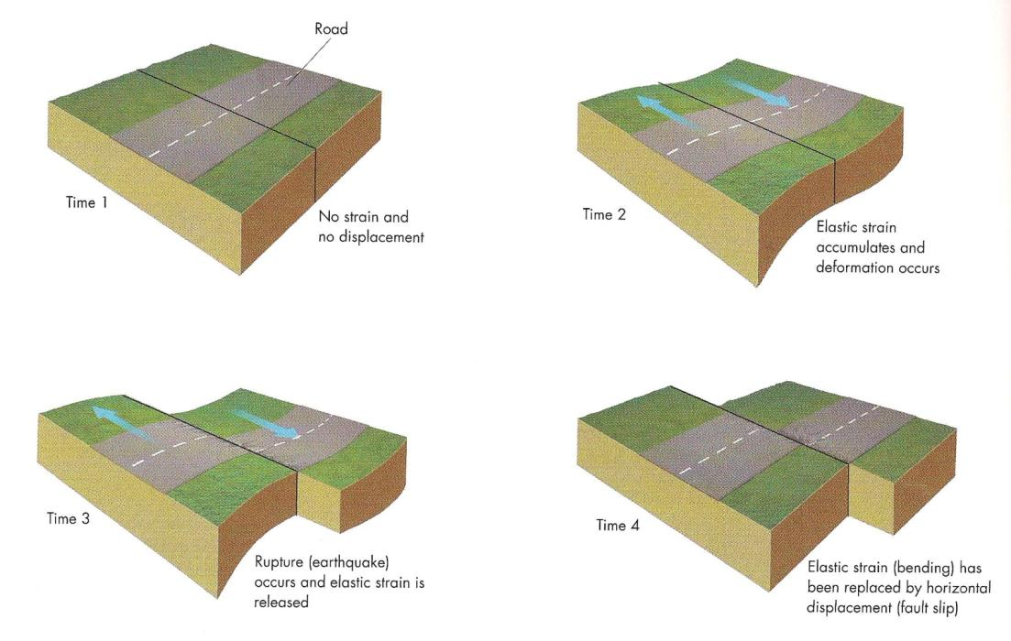
The Earthquake Cycle

Slide 34
The Earthquake Cycle
A typical cycle has several stages:
- an inactive period
A period where strain produces minor earthquakes
A period of foreshocks prior to a major release of stress (this stage does not always occur)
A foreshock is a small to moderate earthquake that occurs shortly before and in the same general area as the mainshock
Mainshock: largest earthquake in a series of associated earthquakes

Slide 35
The Earthquake Cycle
- a period where the mainshock occurs allowing the fault to release built-up stress
Aftershock: small to moderate earthquake that occurs shortly after and in the same general area as the mainshock
The time between each stage varies.

Slide 36
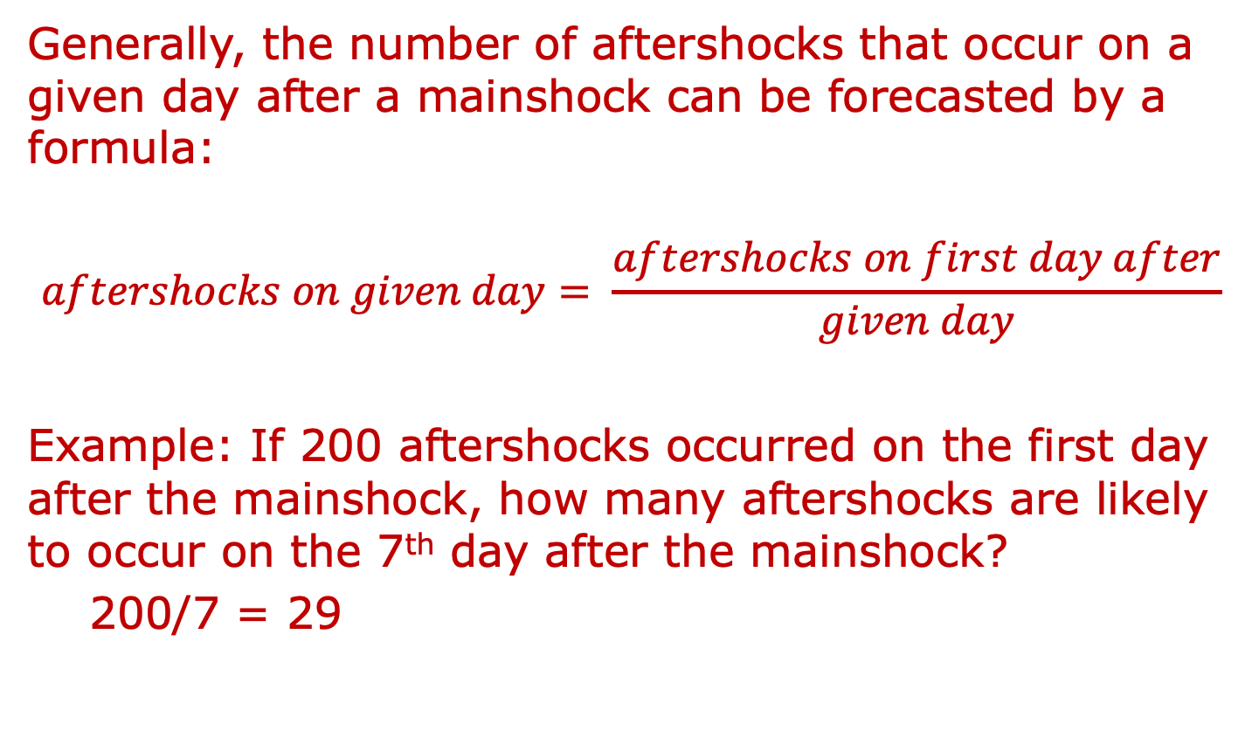
Aftershocks
Generally, the number of aftershocks that occur on a given day after a mainshock can be forecasted by a formula:
$$aftershocks on given day= \frac{aftershocks on first day after}{given day}$$
Example: If 200 aftershocks occurred on the first day after the mainshock, how many aftershocks are likely to occur on the 7th day after the mainshock?
200/7 = 29

Slide 37
Geographic Regions at Risk from Earthquakes
Earthquakes are not randomly distributed.
Most earthquakes occur along plate boundaries:
Pacific Ring of Fire, Himalaya Mountains, Middle East
North American cities at high risk of earthquakes:
Anchorage, Vancouver, Victoria, Seattle, Portland, San Francisco, Los Angeles, Mexico City
However, not all areas at risk of earthquakes are near plate boundaries.

Slide 38
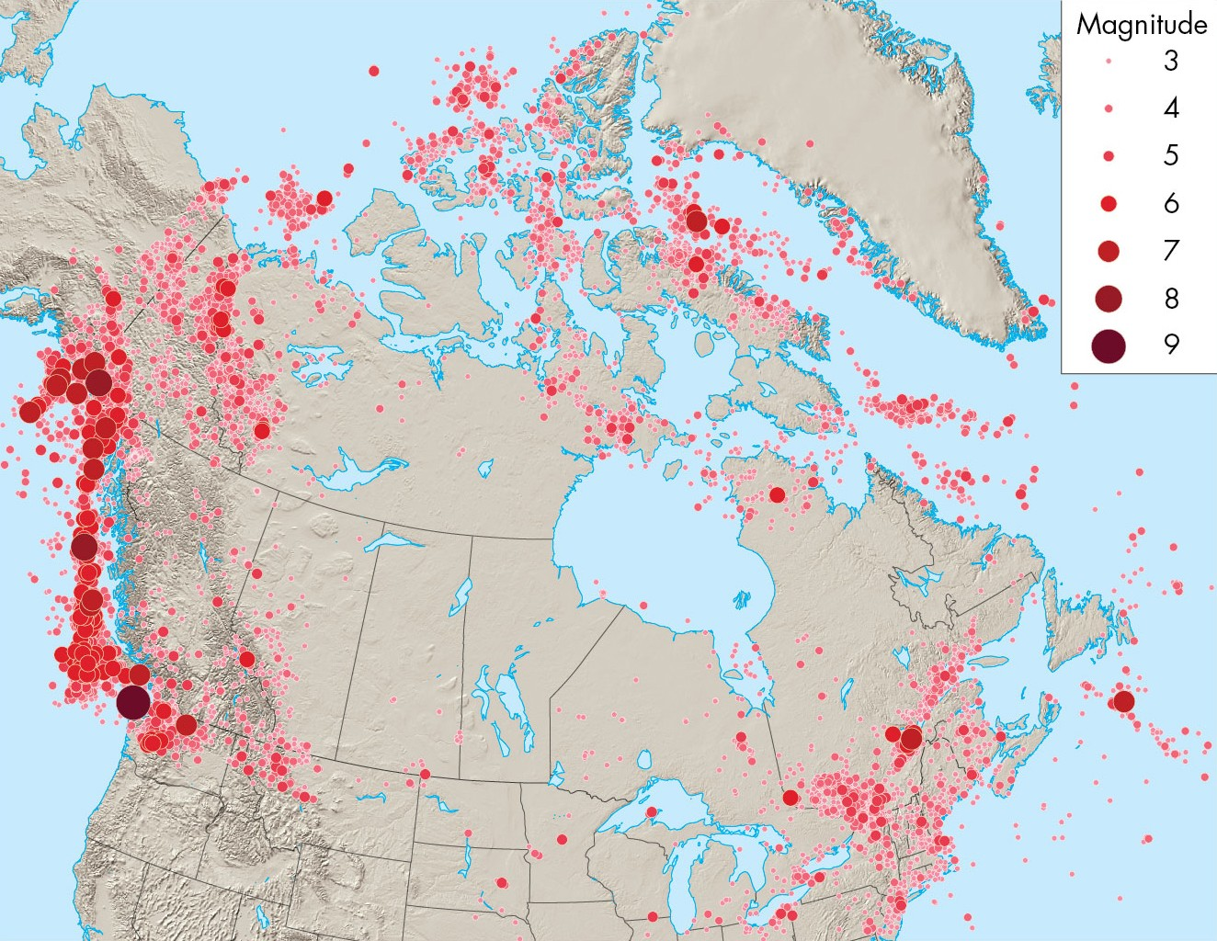
Earthquakes in Canada

Slide 39
Plate Boundary Earthquakes
Definition:
Earthquakes that occur on faults which specifically separate plates
There are three types:
Strike-slip earthquakes
Thrust earthquakes
Normal fault earthquakes

Slide 40
Strike-Slip Earthquakes
These earthquakes occur along transform faults where plates slide horizontally past one another.
They are common in California along the San Andreas fault
The best-known strike-slip earthquake is the Loma Prieta earthquake that disrupted the 1989 World Series in Oakland, California.

Slide 41
Thrust Earthquakes
These earthquakes occur on faults that separate converging plates.
They are also called subduction earthquakes.
They are common off the coast of B.C., Washington, and Oregon
These earthquakes are the strongest on Earth (some are larger than M9) and can produce tsunamis

Slide 42
Normal Fault Earthquakes
These earthquakes occur on faults associated with divergent plate boundaries.
They are common along the Mid-Atlantic Ridge
Most are located under oceans and are generally smaller than M6

Slide 43
Intraplate Earthquakes
Definition:
An earthquake on a fault in the interior of a continent, far from a plate boundary
These earthquakes are typically not as strong as plate boundary earthquakes.
However, damage could be considerable due to lack of preparedness

Slide 44
Intraplate Earthquakes
Because of dense continental bedrock, these earthquakes are felt over large areas.
There are two relatively active intraplate zones in North America: Central Mississippi River Valley and St. Lawrence River Valley
The New Madrid earthquakes in Missouri (1811-12) were over M7.5 and felt across the entire continent.
Recurrence Interval: time between successive events
The recurrence interval in this area is likely several hundred years

Slide 45
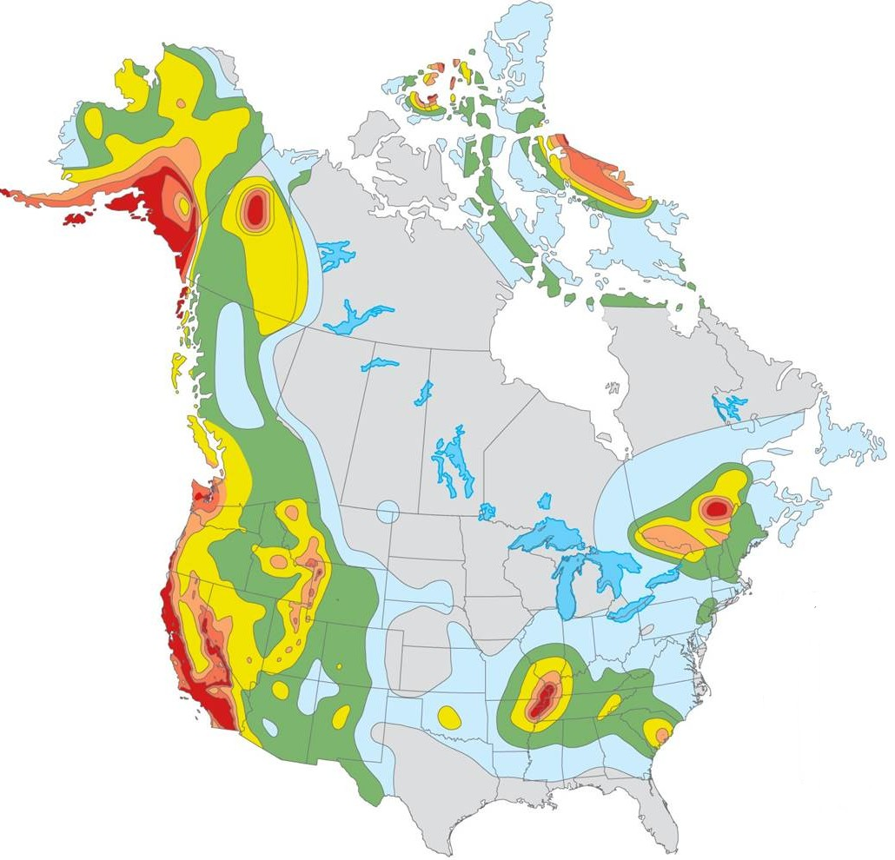
Earthquake Hazard Map

Slide 46
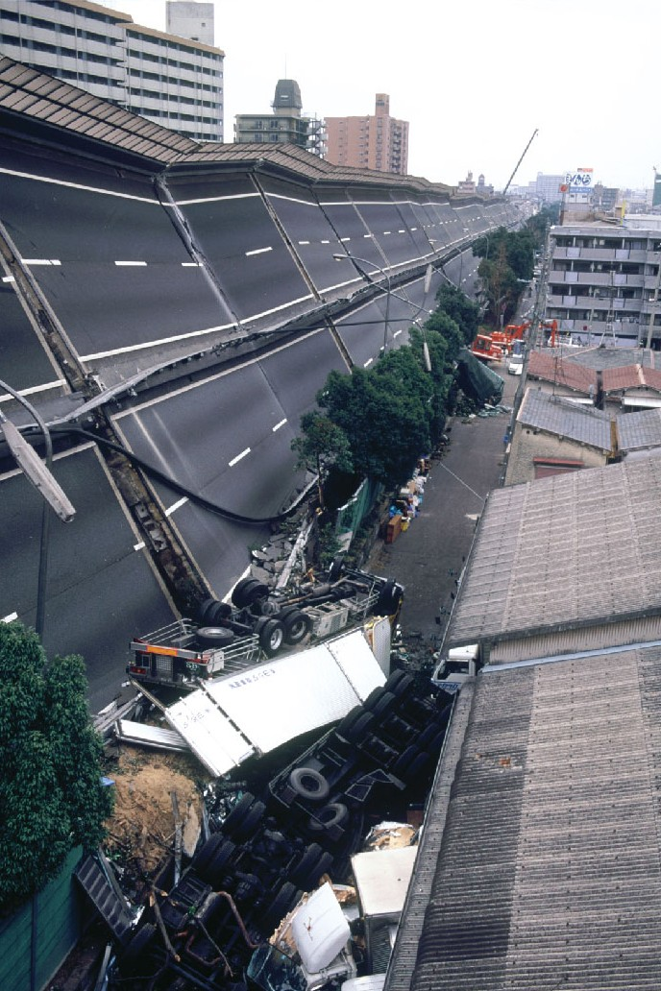
Effects of Earthquakes
Several effects related to earthquakes contribute to deaths and property destruction.
Primary effects:
Ground shaking, surface rupture
Secondary effects:
Liquefaction, land-level change, landslides, fire, tsunamis

Slide 47
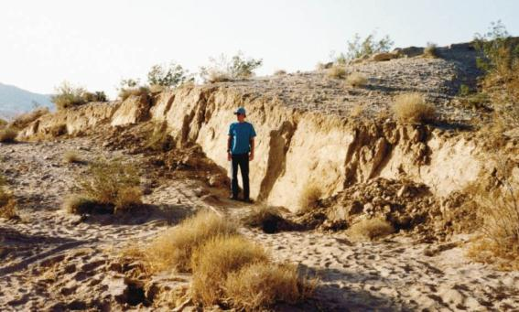
Surface Rupture
Displacement along faults causes cracks in the surface.
During a strong earthquake, fault scarps can be produced that extend for hundreds of kilometers
Fault Scarp: a linear escarpment at Earth’s surface formed by movement along a fault during a an earthquake

Slide 48
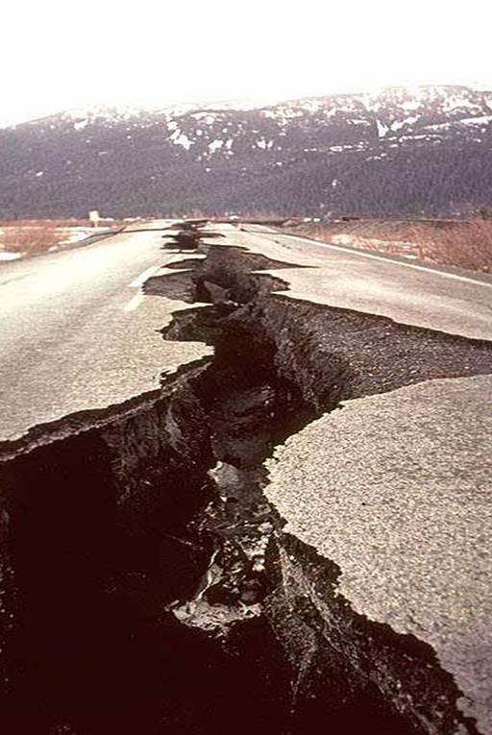
Surface Rupture
Surface rupture can uproot trees, collapse buildings, and destroy bridges, tunnels, and pipelines.

Slide 49
Liquefaction
Definition:
The transformation of water-saturated sediment from solid to liquid during an earthquake
It occurs when water pressure becomes high enough to suspend particles of sediment within the soil.
Once the pressure decreases, the sediment compacts and regains its strength

Slide 50
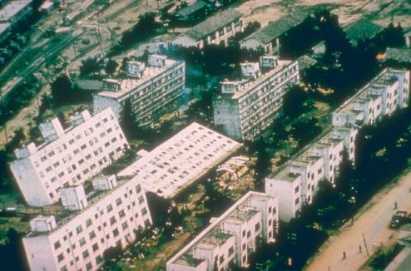
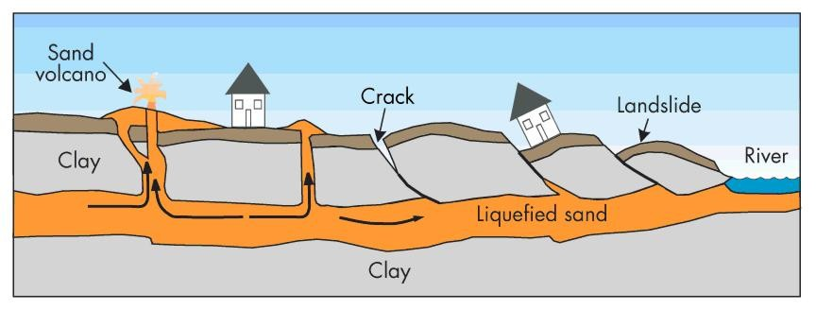
Liquefaction
Watery sand and silt may flow upward along fractures in the overlying rock creating small mounds.
This effect can cause extensive damage.

Slide 51
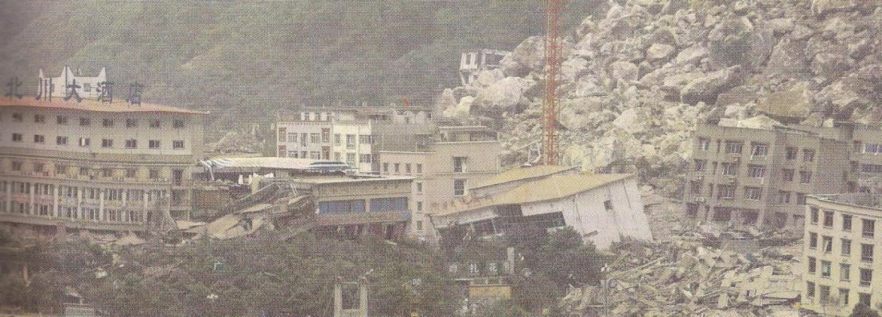
Landslides
Ground shaking produced by an earthquake can cause rock and sediment to move downslope.
A single earthquake in a mountainous area can cause thousands of landslides

Slide 52
Fires
Ground shaking and rupture can start fires by severing power and gas lines.
Appliances may topple over causing gas leaks that may ignite
Approximately 80% of the damage during the 1906 San Francisco earthquake was caused by fire

Slide 53
Natural Service Functions of Earthquakes
Faults provide pathways for the downward flow of surface water.
They can channel groundwater to surface discharge points (springs)
New mineral resources can be exposed; some minerals are preferentially deposited in faults
Scenic landscapes (hills, valleys) develop in fault zones over millions of years.

Slide 54
Earthquakes Caused by Human Activity
Several human activities are known to trigger small to moderate earthquakes.
The weight from water reservoirs produced by dams can create new faults
Injecting liquid waste deep in the earth can increase pressure and cause slippage along fractures
Testing nuclear weapons leads to explosions that may increase strain in an area.

Slide 55
Minimizing the Earthquake Hazard
Earthquakes cause death and destruction because they often occur with little warning.
At present, we can forecast the likelihood that an earthquake will occur in an area, but not precisely when it will occur.
The Geological Surveys of Canada and the U.S. have developed programs to reduce the hazard from earthquakes

Slide 56
Earthquake Hazard Reduction Programs
The programs have five goals:
- improve national seismograph networks
- develop awareness of earthquake sources
- determine earthquake potential
- predict effect of earthquakes on buildings
- communicate research to educate the public

Slide 57
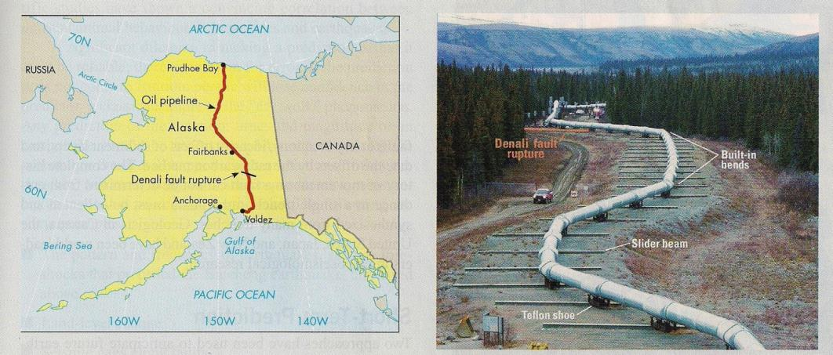
Planning for Earthquakes
The Denali earthquake in Alaska in 2002 demonstrated the value of planning for earthquakes
Where the Trans-Alaska oil pipeline crossed the Denali fault, its construction was altered to withstand a large earthquake.

Slide 58
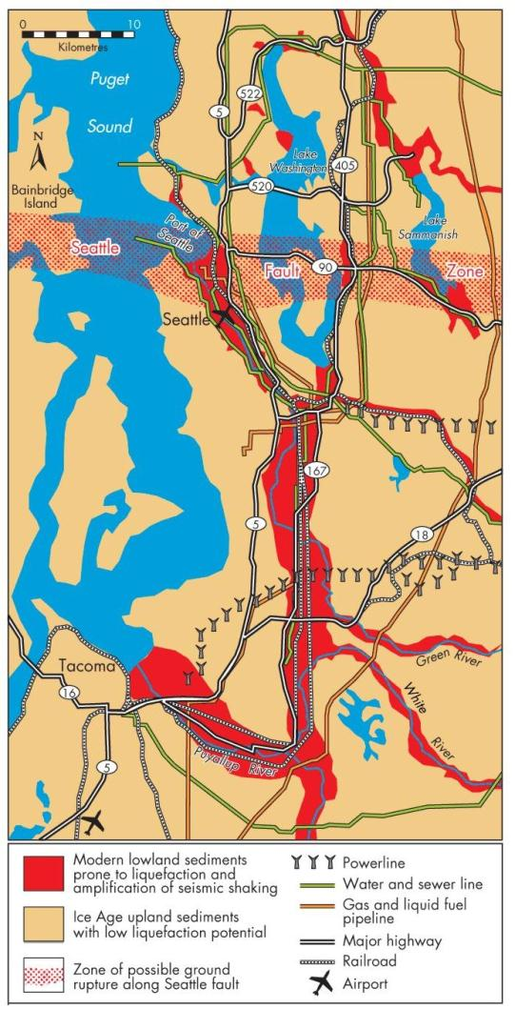
Estimating Seismic Risk
Hazard maps identify areas of risk associated with earthquake effects.
They include areas prone to liquefaction, zones of potential ground rupture, and historic epicenters

Slide 59
Precursors to Earthquakes
If higher accuracy forecasts become possible, they will most likely be based on precursors:
1. The pattern and frequency of smaller ruptures
- based on foreshocks and microearthquakes
2. Land-level change
- uplift or subsidence may precede earthquakes
- GPS can recognize small changes in elevation

Slide 60
Precursors to Earthquakes
3. Seismic gaps along faults
- areas along a fault that have not seen recent earthquakes may be more likely to experience one
4. Physical and chemical changes
- changes in groundwater level and chemistry may occur if rocks expand prior to an earthquake

Slide 61
Earthquake Forecasting
There have been modest incidences of successfully forecasting earthquakes.
All forecasts must be scientifically reviewed before they are released
Research projects along the San Andreas Fault aim to improve understanding.
Current warning systems provide 15 to 30 seconds of warning and only warn of a major earthquake that has already occurred.

Slide 62
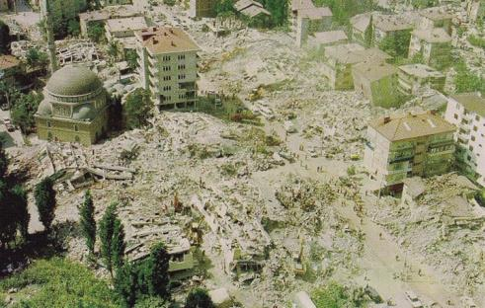
Perception of the Earthquake Hazard
Survivors of strong earthquakes often report traumatic stress.
Typically, one community’s experience with an earthquake has not stimulated other communities to enhance their preparedness
Earthquakes have exposed
shoddy construction practices.

Slide 63
Community Adjustments to the Earthquake Hazard
It is not possible to prevent people from living in earthquake-prone areas.
Therefore, several steps are necessary to minimize seismic risk:
Critical facilities should be located as safely as possible
- buildings must be designed to withstand vibrations (retrofitting may be required)

Slide 64
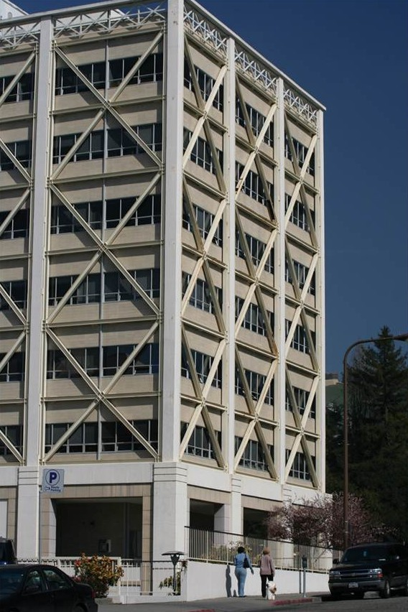

Community Adjustments to the Earthquake Hazard
- education is a component of preparedness (workshops, training sessions, earthquake drills)
Earthquake insurance should be made available in high-risk areas

Slide 65
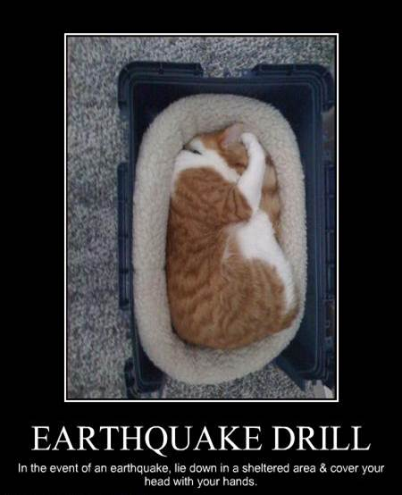
Personal Adjustments
Most earthquake casualties result from building collapse and falling objects.
During an earthquake, it is best to stay away from windows and tall furniture.
The safest locations are under desks or tables

